Slide 1
DevSecOps
The DevSecOps stands for development, security and operations
It empowers the team to develop secure applications without compromising agility and quality
It creates Trust and Confidence
DevSecOps is not Audit process & not checkbox

Slide 2
DevOps Pipeline
Azure
Aws
Terraform
Google Cloud
Ansible
Splunk
Amazon Cloud Watch
Azure Monitor
Nagios
GitHub
BitBucket
Azure Repos
TeamCity
Jenkin
Bamboo
Cucumber
Apache Jmeter
SoopUI
Maven
Jfrog Artifactory
Source Code
CI Server
Test and Scan
Artifacts
Deploy
Monitor

Slide 3
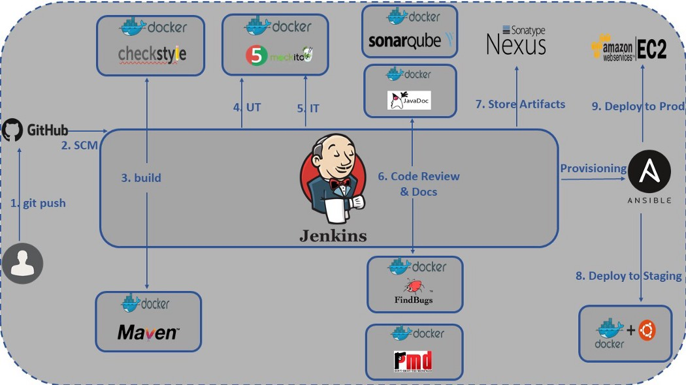
DevOps Pipeline

Slide 4
DevSecOps Tools
The following tools used in DevSecOps pipeline
SonarQube: Use for checking code quality, It provides continuous feedback for code quality
ThreadModeler: Provides treat modeling solution that scales and secures application
Aqua Security: Provides prevention, detection and response automation to secure build, secure cloud infrastructure
Check Matrix: Complete suite for software security applications, this suite provides security testing for static and dynamic applications
Fortify: Provides application security as a service
HashiCorp Vault: Manages secrets like passwords, tokens, API keys, certificates
SAST: (Static Application Security Testing) – It is Whitebox method to test security of code
It examines and finds loopholes in code such as SQL Injection
Ex: SonarQube, Check Matrix, Fortify
DAST: (Dynamic Application Security Testing) – It is Blackbox method to test security of code
It examines and finds loopholes in code while application running
Ex: Netsparker, Astra’s Security Scanner, AppScan
IAST: (Interactive Application Security Testing): Used during QA phase of SDLC, More efficient than DAST
Ex: Veracode, Synopsys Seeker

